Slide 1
Chapter 4: Methods and Encapsulation

Slide 2
OCA EXAM OBJECTIVES COVERED IN THIS CHAPTER:
Working with Methods and Encapsulation
■ Create methods with arguments and return values; including
overloaded methods
■ Apply the static keyword to methods and fields
■ Create and overload constructors; include impact on default
constructors
■ Apply access modifiers
■ Apply encapsulation principles to a class
■ Determine the effect upon object references and primitive
values when they are passed into methods that change the
values
Working with Selected classes from the Java API
■ Write a simple Lambda expression that consumes a Lambda
Predicate expression

Slide 3
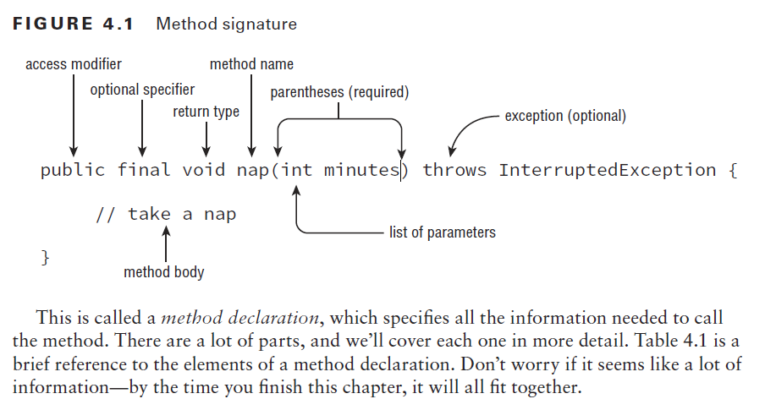
Designing Methods
4.

Slide 4
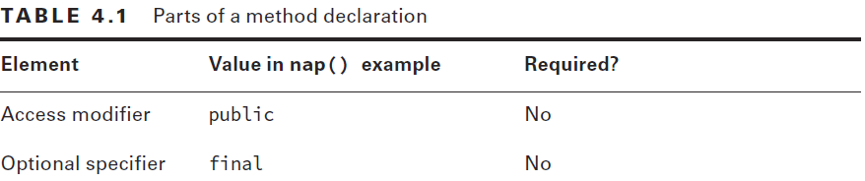
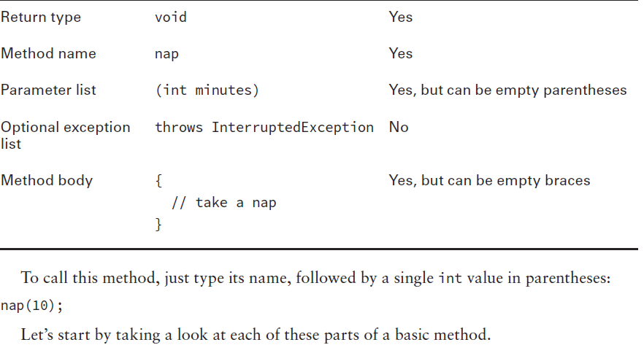

Slide 5
Access Modifiers
public The method can be called from any class.
private The method can only be called from within the same class.
protected The method can only be called from classes in the same package or subclasses.
Default (Package Private) Access The method can only be called from classes in the same package. This one is tricky because there is no keyword for default access. You simply omit the access modifier.

Slide 6
Example
public void walk1() {}
default void walk2() {}
void public walk3() {}
void walk4() {}

Slide 7
Example
public void walk1() {}
default void walk2() {} // DOES NOT COMPILE
void public walk3() {} // DOES NOT COMPILE
void walk4() {}
walk1() is a valid method declaration with public access. walk4() is a valid method
declaration with default access. walk2() doesn’t compile because default is not a valid access
modifier. walk3() doesn’t compile because the access modifier is specified after the return
type.

Slide 8
Optional Specifiers
static Covered later in this chapter. Used for class methods.
abstract Covered in Chapter 5. Used when not providing a method body.
final Covered in Chapter 5. Used when a method is not allowed to be overridden by a subclass.
synchronized On the OCP but not the OCA exam.
native Not on the OCA or OCP exam. Used when interacting with code written in another language such as C++.
strictfp Not on the OCA or OCP exam. Used for making floating-point calculations portable.

Slide 9
Example
public void walk1() {}
public final void walk2() {}
public static final void walk3() {}
public final static void walk4() {}
public modifier void walk5() {}
public void final walk6() {}
final public void walk7() {}

Slide 10
Example
public void walk1() {}
public final void walk2() {}
public static final void walk3() {}
public final static void walk4() {}
public modifier void walk5() {} // DOES NOT COMPILE
public void final walk6() {} // DOES NOT COMPILE
final public void walk7() {}
walk1() is a valid method declaration with no optional specifier. This is okay; it is optional, after all. walk2() is a valid method declaration, with final as the optional specifier. walk3() and walk4() are valid method declarations with both final and static as optional specifiers. The order of these two keywords doesn’t matter. walk5() doesn’t compile because modifier is not a valid optional specifier. walk6() doesn’t compile because the optional specifier is after the return type.
walk7() does compile. Java allows the optional specifiers to appear before the access modifier. This is a weird case and not one you need to know for the exam.

Slide 11
Return Type
The next item in a method declaration is the return type. The return type might be an actual Java type such as String or int. If there is no return type, the void keyword is used.
When checking return types, you also have to look inside the method body. Methods with a return type other than void are required to have a return statement inside the method body. This return statement must include the primitive or object to be returned.
Methods that have a return type of void are permitted to have a return statement with no value returned or omit the return statement entirely.

Slide 12
Example
public void walk1() { }
public void walk2() { return; }
public String walk3() { return ""; }
public String walk4() { }
public walk5() { }
String walk6(int a) { if (a == 4) return ""; }

Slide 13
Example
public void walk1() { }
public void walk2() { return; }
public String walk3() { return ""; }
public String walk4() { } // DOES NOT COMPILE
public walk5() { } // DOES NOT COMPILE
String walk6(int a) { if (a == 4) return ""; } // DOES NOT COMPILE
Since the return type of walk1() is void, the return statement is optional. walk2() shows the optional return statement that correctly doesn’t return anything. walk3() is a valid method with a String return type and a return statement that returns a String. walk4() doesn’t compile because the return statement is missing. walk5() doesn’t compile because the return type is missing.
walk6() is a little tricky. There is a return statement, but it doesn’t always get run. If a is 6, the return statement doesn’t get executed. Since the String always needs to be returned, the compiler complains.

Slide 14
When returning a value, it needs to be assignable to the return type.
The type of the local variable matches the return type of the method. Then you return that local variable instead of the value directly:
int integerExpanded() {
int temp = 9;
return temp;
}
int longExpanded() {
int temp = 9L; // DOES NOT COMPILE
return temp;
}
This shows more clearly why you can’t return a long primitive in a method that returns
an int. You can’t stuff that long into an int variable, so you can’t return it directly either.

Slide 15
Method Name
Method names follow the same rules as we practiced with variable names in Chapter 1, “Java Building Blocks.” To review, an identifier may only contain letters, numbers, $, or _.
Also, the first character is not allowed to be a number, and reserved words are not allowed.
By convention, methods begin with a lowercase letter but are not required to.

Slide 16
Example
public void walk1() { }
public void 2walk() { }
public walk3 void() { }
public void Walk_$() { }
public void() { }

Slide 17
Example
public void walk1() { }
public void 2walk() { } // DOES NOT COMPILE
public walk3 void() { } // DOES NOT COMPILE
public void Walk_$() { }
public void() { } // DOES NOT COMPILE
walk1() is a valid method declaration with a traditional name. 2walk() doesn't compile because identifiers are not allowed to begin with numbers. walk3() doesn't compile because the method name is before the return type. Walk_$() is a valid method declaration. While it certainly isn't good practice to start a method name with a capital letter and end with punctuation, it is legal. The final line of code doesn't compile because the method name is missing.

Slide 18
Parameter List
Although the parameter list is required, it doesn’t have to contain any parameters. This means you can just have an empty pair of parentheses after the method name, such as void nap(){}. If you do have multiple parameters, you separate them with a comma.
There are a couple more rules for the parameter list that you’ll see when we cover varargs shortly.

Slide 19
Example
public void walk1() { }
public void walk2 { }
public void walk3(int a) { }
public void walk4(int a; int b) { }
public void walk5(int a, int b) { }

Slide 20
Example
public void walk1() { }
public void walk2 { } // DOES NOT COMPILE
public void walk3(int a) { }
public void walk4(int a; int b) { } // DOES NOT COMPILE
public void walk5(int a, int b) { }
walk1() is a valid method declaration without any parameters. walk2() doesn't compile because it is missing the parentheses around the parameter list. walk3() is a valid method declaration with one parameter. walk4() doesn't compile because the parameters are separated by a semicolon rather than a comma. Semicolons are for separating statements, not parameter lists. walk5() is a valid method declaration with two parameters.

Slide 21
Optional Exception List
In Java, code can indicate that something went wrong by throwing an exception. We’ll cover this in Chapter 6, “Exceptions.” For now, you just need to know that it is optional and where in the method signature it goes if present. In the example, InterruptedException is a type of Exception. You can list as many types of exceptions as you want in this clause separated by commas.
public void zeroExceptions() { }
public void oneException() throws IllegalArgumentException { }
public void twoExceptions() throws
IllegalArgumentException, InterruptedException { }

Slide 22
Method Body
The final part of a method declaration is the method body (except for abstract methods and interfaces). A method body is simply a code block. It has braces that contain zero or more Java statements.
public void walk1() { }
public void walk2; // DOES NOT COMPILE
public void walk3(int a) { int name = 5; }
walk1() is a valid method declaration without an empty method body. walk2() doesn't compile because it is missing the braces around the empty method body. walk3() is a valid method declaration with one statement in the method body.

Slide 23
Working with Varargs
As you saw in the previous chapter, a method may use a vararg parameter (variable argument) as if it is an array. It is a little different than an array, though.
A vararg parameter must be the last element in a method’s parameter list. This implies you are only allowed to have one vararg parameter per method.
public void walk1(int... nums) { }
public void walk2(int start, int... nums) { }
public void walk3(int... nums, int start) { }
public void walk4(int... start, int... nums) { }

Slide 24
Example
public void walk1(int... nums) { }
public void walk2(int start, int... nums) { }
public void walk3(int... nums, int start) { } // DOES NOT COMPILE
public void walk4(int... start, int... nums) { } // DOES NOT COMPILE
walk1() is a valid method declaration with one vararg parameter. walk2() is a valid
method declaration with one int parameter and one vararg parameter. walk3() and
walk4() do not compile because they have a vararg parameter in a position that is not the last one.

Slide 25
Varargs
When calling a method with a vararg parameter, you have a choice. You can pass in an array, or you can list the elements of the array and let Java create it for you. You can even omit the vararg values in the method call and Java will create an array of length zero for you.
15: public static void walk(int start, int... nums) {
16: System.out.println(nums.length);
17: }
18: public static void main(String[] args) {
19: walk(1);
20: walk(1, 2);
21: walk(1, 2, 3);
22: walk(1, new int[] {4, 5});
23: }

Slide 26
Example
15: public static void walk(int start, int... nums) {
16: System.out.println(nums.length);
17: }
18: public static void main(String[] args) {
19: walk(1); // 0
20: walk(1, 2); // 1
21: walk(1, 2, 3); // 2
22: walk(1, new int[] {4, 5}); // 2
23: }
Line 19 passes 1 as start but nothing else. This means Java creates an array of length 0 for nums. Line 20 passes 1 as start and one more value. Java converts this one value to an array of length 1. Line 21 passes 1 as start and two more values. Java converts these two values to an array of length 2. Line 22 passes 1 as start and an array of length 2 directly as nums.

Slide 27
Varargs
You’ve seen that Java will create an empty array if no parameters are passed for a vararg. However, it is still possible to pass null explicitly:
walk(1, null); // throws a NullPointerException
Since null isn’t an int, Java treats it as an array reference that happens to be null. It just passes on the null array object to walk. Then the walk() method throws an exception because it tries to determine the length of null.

Slide 28
Accesing values
Accessing a vararg parameter is also just like accessing an array. It uses array indexing. For example:
16: public static void run(int... nums) {
17: System.out.println(nums[1]);
18: }
19: public static void main(String[] args) {
20: run(11, 22); // 22
21: }
Line 20 calls a vararg parameter two parameters. When the method gets called, it sees an array of size 2. Since indexes are 0 based, 22 is printed.

Slide 29
Applying Access Modifiers
You already saw that there are four access modifiers: public, private, protected, and default access. We are going to discuss them in order from most restrictive to least restrictive:
■ private: Only accessible within the same class
■ default (package private) access: private and other classes in the same package
■ protected: default access and child classes
■ public: protected and classes in the other packages

Slide 30
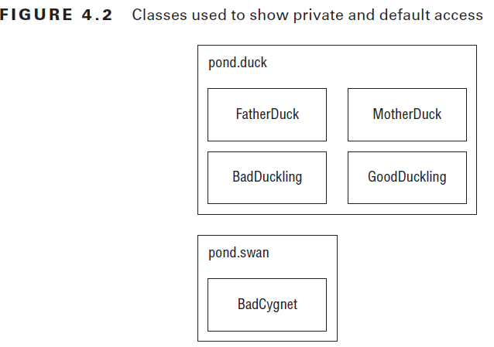
Private Access
Private access is easy. Only code in the same class can call private methods or access
private fields.
1: package pond.duck;
2: public class FatherDuck {
3: private String noise = "quack";
4: private void quack() {
5: System.out.println(noise);
6: }
7: private void makeNoise() {
8: quack();
9: } }

Slide 31
Example
So far, so good. FatherDuck makes a call to private method quack() on line 8 and uses private instance variable noise on line 5.
Now we add another class:
1: package pond.duck;
2: public class BadDuckling {
3: public void makeNoise() {
4: FatherDuck duck = new FatherDuck();
5: duck.quack();
6: System.out.println(duck.noise);
7: } }

Slide 32
Example
1: package pond.duck;
2: public class BadDuckling {
3: public void makeNoise() {
4: FatherDuck duck = new FatherDuck();
5: duck.quack(); // DOES NOT COMPILE
6: System.out.println(duck.noise); // DOES NOT COMPILE
7: } }
BadDuckling is trying to access members it has no business touching. On line 5, it tries to access a private method in another class. On line 6, it tries to access a private instance variable in another class. Both generate compiler errors.

Slide 33
Default (Package Private) Access
When there is no access modifier, Java uses the default, which is package private access. This means that the member is “private” to classes in the same package. In other words, only classes in the package may access it.

Slide 34
Example 1
package pond.duck;
public class MotherDuck {
String noise = "quack";
void quack() {
System.out.println(noise); // default access is ok
}
private void makeNoise() {
quack(); // default access is ok
} }
MotherDuck can call quack() and refer to noise. After all, members in the same class are certainly in the same package. The big difference is MotherDuck lets other classes in the same package access members (due to being package private) whereas FatherDuck doesn’t(due to being private).

Slide 35
Example 2
package pond.duck;
public class GoodDuckling {
public void makeNoise() {
MotherDuck duck = new MotherDuck();
duck.quack(); // default access
System.out.println(duck.noise); // default access
} }
GoodDuckling succeeds in learning to quack() and make noise by copying its mother. Notice that all the classes we’ve covered so far are in the same package pond.duck. This allows default (package private) access to work.

Slide 36
Example 3
In this same pond, a swan just gave birth to a baby swan. A baby swan is called a cygnet.
The cygnet sees the ducklings learning to quack and decides to learn from MotherDuck as well.
package pond.swan;
import pond.duck.MotherDuck; // import another package
public class BadCygnet {
public void makeNoise() {
MotherDuck duck = new MotherDuck();
duck.quack(); // DOES NOT COMPILE
System.out.println(duck.noise); // DOES NOT COMPILE
} }
BadCygnet is in the pond.swan package and the code doesn’t compile. Remember that when there is no access modifier, only classes in the same package can access it.

Slide 37
Protected Access
Protected access allows everything that default (package private) access allows and more. The protected access modifier adds the ability to access members of a parent class. We’ll cover creating subclasses in depth in Chapter 5. For now, we’ll cover the simplest possible use of a child class.
Notes:
Если тип желаемого массива не Object, на вход toArray() обязательно нужно передать массив нужного типа.
Если размера переданного в toArray() массива недостаточно, метод создаст и вернет новый массив, заполненный значениями из ArrayList.

Slide 38
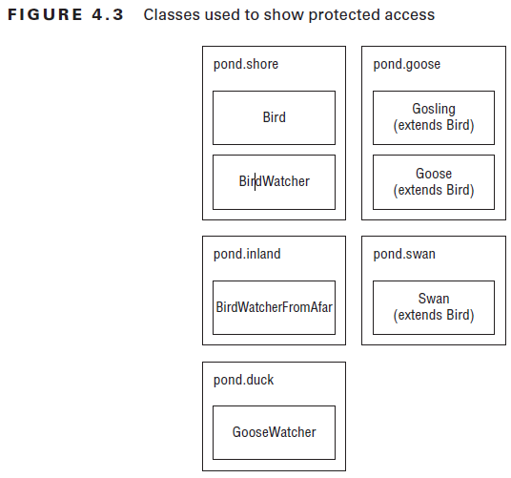
Class Hierarchy
First, we create a Bird class and give protected access to its members:
package pond.shore;
public class Bird {
protected String text = "floating"; // protected access
protected void floatInWater() { // protected access
System.out.println(text);
} }
Next we create a subclass:
package pond.goose;
import pond.shore.Bird; // in a different package
public class Gosling extends Bird { // extends means create subclass
public void swim() {
floatInWater(); // calling protected member
System.out.println(text); // calling protected member
} }

Slide 39
Example 1
Remember that protected also gives us access to everything that default access does. This means that a class in the same package as Bird can access its protected members.
package pond.shore; // same package as Bird
public class BirdWatcher {
public void watchBird() {
Bird bird = new Bird();
bird.floatInWater(); // calling protected member
System.out.println(bird.text); // calling protected member
} }
Notes:
Если тип желаемого массива не Object, на вход toArray() обязательно нужно передать массив нужного типа.
Если размера переданного в toArray() массива недостаточно, метод создаст и вернет новый массив, заполненный значениями из ArrayList.

Slide 40
Example 2
Now let’s try the same thing from a different package:
package pond.inland;
import pond.shore.Bird; // different package than Bird
public class BirdWatcherFromAfar {
public void watchBird() {
Bird bird = new Bird();
bird.floatInWater();
System.out.println(bird.text);
} }
Notes:
Если тип желаемого массива не Object, на вход toArray() обязательно нужно передать массив нужного типа.
Если размера переданного в toArray() массива недостаточно, метод создаст и вернет новый массив, заполненный значениями из ArrayList.

Slide 41
Example 2
package pond.inland;
import pond.shore.Bird; // different package than Bird
public class BirdWatcherFromAfar {
public void watchBird() {
Bird bird = new Bird();
bird.floatInWater(); // DOES NOT COMPILE
System.out.println(bird.text); // DOES NOT COMPILE
} }
BirdWatcherFromAfar is not in the same package as Bird and it doesn’t inherit from Bird. This means that it is not allowed to access protected members of Bird.
Subclasses and classes in the same package are the only ones allowed to access protected members.
Notes:
Если тип желаемого массива не Object, на вход toArray() обязательно нужно передать массив нужного типа.
Если размера переданного в toArray() массива недостаточно, метод создаст и вернет новый массив, заполненный значениями из ArrayList.

Slide 42
Example 3 (Brainf***)
1: package pond.swan;
2: import pond.shore.Bird; // in different package than Bird
3: public class Swan extends Bird { // but subclass of bird
4: public void swim() {
5: floatInWater(); // package access to superclass
6: System.out.println(text); // package access to superclass
7: }
8: public void helpOtherSwanSwim() {
9: Swan other = new Swan();
10: other.floatInWater(); // package access to superclass
11: System.out.println(other.text);// package access to superclass
12: }
13: public void helpOtherBirdSwim() {
14: Bird other = new Bird();
15: other.floatInWater();
16: System.out.println(other.text);}}
Notes:
Если тип желаемого массива не Object, на вход toArray() обязательно нужно передать массив нужного типа.
Если размера переданного в toArray() массива недостаточно, метод создаст и вернет новый массив, заполненный значениями из ArrayList.

Slide 43
Example 3 (Brainf***)
1: package pond.swan;
2: import pond.shore.Bird; // in different package than Bird
3: public class Swan extends Bird { // but subclass of bird
4: public void swim() {
5: floatInWater(); // package access to superclass
6: System.out.println(text); // package access to superclass
7: }
8: public void helpOtherSwanSwim() {
9: Swan other = new Swan();
10: other.floatInWater(); // package access to superclass
11: System.out.println(other.text);// package access to superclass
12: }
13: public void helpOtherBirdSwim() {
14: Bird other = new Bird();
15: other.floatInWater(); // DOES NOT COMPILE
16: System.out.println(other.text);}} // DOES NOT COMPILE
Notes:
Если тип желаемого массива не Object, на вход toArray() обязательно нужно передать массив нужного типа.
Если размера переданного в toArray() массива недостаточно, метод создаст и вернет новый массив, заполненный значениями из ArrayList.

Slide 44
Example 3 (Brainf***). Explanation
Swan is not in the same package as Bird, but does extend it—which implies it has access to the protected members of Bird since it is a subclass.
Lines 5 and 6 refer to protected members via inheriting them.
Lines 10 and 11 also successfully use protected members of Bird. This is allowed
because these lines refer to a Swan object. Swan inherits from Bird so this is okay. It is sort
of a two-phase check. The Swan class is allowed to use protected members of Bird and we
are referring to a Swan object. Granted, it is a Swan object created on line 9 rather than an
inherited one, but it is still a Swan object.
Lines 15 and 16 do not compile. Wait a minute. They are almost exactly the same as
lines 10 and 11! There’s one key difference. This time a Bird reference is used. It is created
on line 14. Bird is in a different package, and this code isn’t inheriting from Bird, so it
doesn’t get to use protected members. We just got through saying repeatedly
that Swan inherits from Bird. And it does. However, the variable reference isn’t a Swan.
The code just happens to be in the Swan class.
Notes:
Если тип желаемого массива не Object, на вход toArray() обязательно нужно передать массив нужного типа.
Если размера переданного в toArray() массива недостаточно, метод создаст и вернет новый массив, заполненный значениями из ArrayList.

Slide 45
Example 4
package pond.goose;
import pond.shore.Bird;
public class Goose extends Bird {
public void helpGooseSwim() {
Goose other = new Goose();
other.floatInWater();
System.out.println(other.text);
}
public void helpOtherGooseSwim() {
Bird other = new Goose();
other.floatInWater();
System.out.println(other.text);
} }
Notes:
Если тип желаемого массива не Object, на вход toArray() обязательно нужно передать массив нужного типа.
Если размера переданного в toArray() массива недостаточно, метод создаст и вернет новый массив, заполненный значениями из ArrayList.

Slide 46
Example 4
The first method is fine. In fact, it is equivalent to the Swan example. Goose extends Bird. Since we are in the Goose subclass and referring to a Goose reference, it can access protected members.
The second method is a problem. Although the object happens to be a Goose, it is stored in a Bird reference. We are not allowed to refer to members of the Bird
class since we are not in the same package and Bird is not a subclass of Bird.
package pond.goose;
import pond.shore.Bird;
public class Goose extends Bird {
public void helpGooseSwim() {
Goose other = new Goose();
other.floatInWater();
System.out.println(other.text);
}
public void helpOtherGooseSwim() {
Bird other = new Goose();
other.floatInWater(); // DOES NOT COMPILE
System.out.println(other.text); // DOES NOT COMPILE
} }
Notes:
Если тип желаемого массива не Object, на вход toArray() обязательно нужно передать массив нужного типа.
Если размера переданного в toArray() массива недостаточно, метод создаст и вернет новый массив, заполненный значениями из ArrayList.

Slide 47
Conclusion
The protected rules apply under two scenarios:
■ A member is used without referring to a variable. This is the case on lines 5 and 6. In this case, we are taking advantage of inheritance and protected access is allowed.
■ A member is used through a variable. This is the case on lines 10, 11, 15, and 16.
In this case, the rules for the reference type of the variable are what matter. If it is a subclass, protected access is allowed. This works for references to the same class or a subclass.
Notes:
Если размера массива достаточно, toArray() вернет переданный на вход массив.

Slide 48
Public Access
package pond.duck;
public class DuckTeacher {
public String name = "helpful"; // public access
public void swim() { // public access
System.out.println("swim");
} }
DuckTeacher allows access to any class that wants it. Now we can try it out:
package pond.goose;
import pond.duck.DuckTeacher;
public class LostDuckling {
public void swim() {
DuckTeacher teacher = new DuckTeacher();
teacher.swim(); // allowed
System.out.println("Thanks" + teacher.name); // allowed
} }

Slide 49
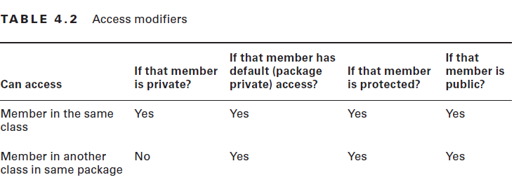
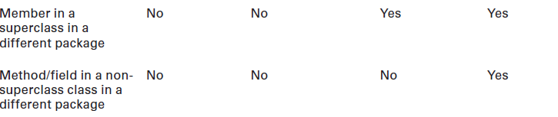
Access modifiers

Slide 50
Designing Static Methods and Fields
Except for the main() method, we’ve been looking at instance methods. Static methods don’t require an instance of the class. They are shared among all users of the class. You can think of statics as being a member of the single class object that exist independently of any instances of that class.
Each class has a copy of the instance variables. There is only one copy of the code for the instance methods. Each instance of the class can call it as many times as it would like.
However, each call of an instance method (or any method) gets space on the stack for method parameters and local variables.
The same thing happens for static methods. There is one copy of the code. Parameters and local variables go on the stack.
Just remember that only data gets its “own copy.” There is no need to duplicate copies of the code itself.
Notes:
Если размера массива достаточно, toArray() вернет переданный на вход массив.

Slide 51
Example 1
public class Koala {
public static int count = 0; // static variable
public static void main(String[] args) { // static method
System.out.println(count);
}
}
We said that the JVM basically calls Koala.main() to get the program started. You can do this too. We can have a KoalaTester that does nothing but call the main() method.
Notes:
Если размера массива достаточно, toArray() вернет переданный на вход массив.

Slide 52
Example 2
public class KoalaTester {
public static void main(String[] args) {
Koala.main(new String[0]); // call static method}}
When we run KoalaTester, it makes a call to the main() method of Koala, which prints the value of count. The purpose of all these examples is to show that main() can be called just like any other static method.
Static methods have two main purposes:
■ For utility or helper methods that don’t require any object state. Since there is no need
to access instance variables, having static methods eliminates the need for the caller to
instantiate the object just to call the method.
■ For state that is shared by all instances of a class, like a counter. All instances must
share the same state. Methods that merely use that state should be static as well.
Notes:
Если размера массива достаточно, toArray() вернет переданный на вход массив.

Slide 53
Calling a Static Variable or Method
Usually, accessing a static member is easy. You just put the classname before the method or variable and you are done. For example:
System.out.println(Koala.count);
Koala.main(new String[0]);
There is one rule that is trickier. You can use an instance of the object to call a static method. The compiler checks for the type of the reference and uses that instead of the object—which is sneaky of Java.
Notes:
Если размера массива достаточно, toArray() вернет переданный на вход массив.

Slide 54
Example
5: Koala k = new Koala();
6: System.out.println(k.count);
7: k = null;
8: System.out.println(k.count);
Notes:
Если размера массива достаточно, toArray() вернет переданный на вход массив.

Slide 55
Example
5: Koala k = new Koala();
6: System.out.println(k.count); // k is a Koala
7: k = null;
8: System.out.println(k.count); // k is still a Koala
This code outputs 0 twice. Line 6 sees that k is a Koala and count is a static variable, so it reads that static variable. Line 8 does the same thing. Java doesn’t care that k happens to be null. Since we are looking for a static, it doesn’t matter.
Notes:
Если размера массива достаточно, toArray() вернет переданный на вход массив.

Slide 56
Example 2
Koala.count = 4;
Koala koala1 = new Koala();
Koala koala2 = new Koala();
koala1.count = 6;
koala2.count = 5;
System.out.println(Koala.count);
Notes:
Если размера массива достаточно, toArray() вернет переданный на вход массив.

Slide 57
Example 2
Koala.count = 4; //4
Koala koala1 = new Koala();
Koala koala2 = new Koala();
koala1.count = 6; //6
koala2.count = 5; //5
System.out.println(Koala.count);
There is only one count variable since it is static. It is set to 4, then 6, and finally winds up as 5. All the Koala variables are just distractions.
Notes:
Если размера массива достаточно, toArray() вернет переданный на вход массив.

Slide 58
Static vs. Instance
A static member cannot call an instance member(Remember that “member” means field or method). This shouldn’t be a surprise since static doesn’t require any instances of the class to be around.
Notes:
Если размера массива достаточно, toArray() вернет переданный на вход массив.

Slide 59
Example
public class Static {
private String name = "Static class";
public static void first() { }
public static void second() { }
public void third() {
System.out.println(name);
}
public static void main(String args[]) {
first();
second();
third();
} }
Notes:
Если размера массива достаточно, toArray() вернет переданный на вход массив.

Slide 60
Example
public class Static {
private String name = "Static class";
public static void first() { }
public static void second() { }
public void third() { System.out.println(name); }
public static void main(String args[]) {
first();
second();
third(); // DOES NOT COMPILE
}}
The compiler will give you an error about making a static reference to a nonstatic method. If we fix this by adding static to third(), we create a new problem. Now, third() is referring to nonstatic name. Adding static to name as well would solve the problem. Another solution would have been to call third as an instance method—for example, new Static().third();.
Notes:
Если размера массива достаточно, toArray() вернет переданный на вход массив.

Slide 61
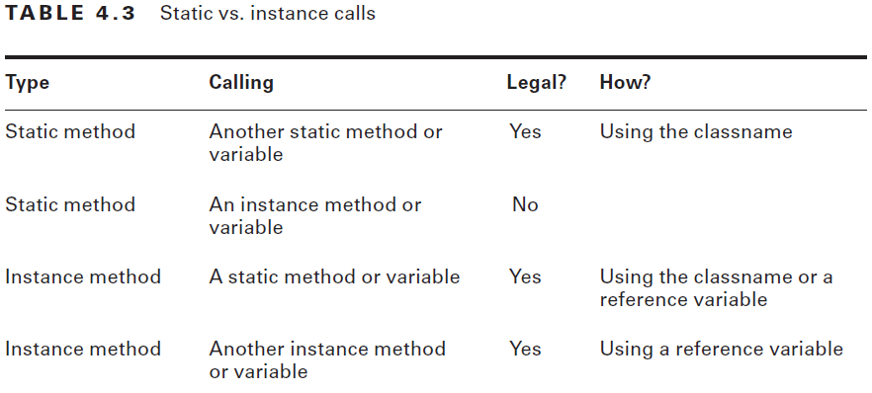
Conclusion
A static method or instance method can call a static method because static methods don’t require an object to use. Only an instance method can call another instance method on the same class without using a reference variable, because instance methods do require an object. Similar logic applies for the instance and static variables.
Notes:
Если размера массива достаточно, toArray() вернет переданный на вход массив.

Slide 62
Example 2
A common use for static variables is counting the number of instances:
public class Counter {
private static int count;
public Counter() { count++; }
public static void main(String[] args) {
Counter c1 = new Counter();
Counter c2 = new Counter();
Counter c3 = new Counter();
System.out.println(count); // 3
}}
Each time the constructor gets called, it increments count by 1. This example relies on the fact that static (and instance) variables are automatically initialized to the default value for that type, which is 0 for int.
Notes:
Если размера массива достаточно, toArray() вернет переданный на вход массив.

Slide 63
Static Variables
Some static variables are meant to change as the program runs. Counters are a common example of this. We want the count to increase over time. Just as with instance variables, you can initialize a static variable on the line it is declared:
public class Initializers {
private static int counter = 0; // initialization
}
Notes:
Если размера массива достаточно, toArray() вернет переданный на вход массив.

Slide 64
Static Variables
Other static variables are meant to never change during the program. This type of variable is known as a constant. It uses the final modifier to ensure the variable never changes. static final constants use a different naming convention than other variables. They use all uppercase letters with underscores between “words.” For example:
public class Initializers {
private static final int NUM_BUCKETS = 45;
public static void main(String[] args) {
NUM_BUCKETS = 5; // DOES NOT COMPILE
} }
Notes:
Если размера массива достаточно, toArray() вернет переданный на вход массив.

Slide 65
Static Variables
The compiler will make sure that you do not accidentally try to update a final variable.This can get interesting. Do you think the following compiles?
private static final ArrayList<String> values = new ArrayList<>();
public static void main(String[] args) {
values.add("changed");
}
It actually does compile. values is a reference variable. We are allowed to call methods
on reference variables. All the compiler can do is check that we don’t try to reassign the
final values to point to a different object.
Notes:
Если размера массива достаточно, toArray() вернет переданный на вход массив.

Slide 66
Static Initialization
In Chapter 1, we covered instance initializers that looked like unnamed methods. Just code
inside braces. Static initializers look similar. They add the static keyword to specify they
should be run when the class is first used. For example:
private static final int NUM_SECONDS_PER_HOUR;
static {
int numSecondsPerMinute = 60;
int numMinutesPerHour = 60;
NUM_SECONDS_PER_HOUR = numSecondsPerMinute * numMinutesPerHour;
}
There is something interesting about this example. We just got through saying that final variables aren’t allowed to be reassigned. The key here is that the static initializer is the first assignment. And since it occurs up front, it is okay.
Notes:
Если размера массива достаточно, toArray() вернет переданный на вход массив.

Slide 67
Example
14: private static int one;
15: private static final int two;
16: private static final int three = 3;
17: private static final int four;
18: static {
19: one = 1;
20: two = 2;
21: three = 3;
22: two = 4;
23: }
Notes:
Если размера массива достаточно, toArray() вернет переданный на вход массив.

Slide 68
Example
14: private static int one;
15: private static final int two;
16: private static final int three = 3;
17: private static final int four; // DOES NOT COMPILE
18: static {
19: one = 1;
20: two = 2;
21: three = 3; // DOES NOT COMPILE
22: two = 4; // DOES NOT COMPILE
23: }
Line 14 declares a static variable that is not fi nal. It can be assigned as many times as we like. Line 15 declares a final variable without initializing it. This means we can initialize it exactly once in a static block. Line 22 doesn’t compile because this is the second attempt. Line 16 declares a final variable and initializes it at the same time. We are not allowed to assign it again, so line 21 doesn’t compile. Line 17 declares a final variable that never gets initialized. The compiler gives a compiler error because it knows that the static blocks are the only place the variable could possibly get initialized. Since the programmer forgot, this is clearly an error.
Notes:
Если размера массива достаточно, toArray() вернет переданный на вход массив.

Slide 69
Static imports
Imports are convenient because you don’t need to specify where each class comes from each time you use it. There is another type of import called a static import. Regular imports are for importing classes. Static imports are for importing static members of classes. Just like regular imports, you can use a wildcard or import a specific member. The idea is that you shouldn’t have to specify where each static method or variable comes from each time you use it. An example of when static interfaces shine are when you are referring to a lot of constants in another class.
Notes:
Если размера массива достаточно, toArray() вернет переданный на вход массив.

Slide 70
Example 1
import java.util.List;
import static java.util.Arrays.asList; // static import
public class StaticImports {
public static void main(String[] args) {
List<String> list = asList("one", "two"); // no Arrays.
} }
In this example, we are specifically importing the asList method. This means that any time we refer to asList in the class, it will call Arrays.asList(). An interesting case is what would happen if we created an asList method in our StaticImports class. Java would give it preference over the imported one and the method we coded would be used.
Notes:
Если размера массива достаточно, toArray() вернет переданный на вход массив.

Slide 71
Example 2
1: import static java.util.Arrays;
2: import static java.util.Arrays.asList;
3: static import java.util.Arrays.*;
4: public class BadStaticImports {
5: public static void main(String[] args) {
6: Arrays.asList("one");
7: } }
Notes:
Если размера массива достаточно, toArray() вернет переданный на вход массив.

Slide 72
Example 2
1: import static java.util.Arrays; // DOES NOT COMPILE
2: import static java.util.Arrays.asList;
3: static import java.util.Arrays.*; // DOES NOT COMPILE
4: public class BadStaticImports {
5: public static void main(String[] args) {
6: Arrays.asList("one"); // DOES NOT COMPILE
7: } }
Line 1 tries to use a static import to import a class. Remember that static imports are only for importing static members. Regular imports are for importing a class. Line 3 tries to see if you are paying attention to the order of keywords. The syntax is import static and not vice versa. Line 6 is sneaky. We imported the asList method on line 2. However, we did not import the Arrays class anywhere. This makes it okay to write asList("one"); but not Arrays.asList("one");.
Notes:
Если размера массива достаточно, toArray() вернет переданный на вход массив.

Slide 73
Example 3
There’s only one more scenario with static imports. In Chapter 1, you learned that importing two classes with the same name gives a compiler error. This is true of static imports as well. The compiler will complain if you try to explicitly do a static import of two methods with the same name or two static variables with the same name. For example:
import static statics.A.TYPE;
import static statics.B.TYPE; // DOES NOT COMPILE
Luckily when this happens, we can just refer to the static members via their classname in the code instead of trying to use a static import.
Notes:
Если размера массива достаточно, toArray() вернет переданный на вход массив.

